Slide 1
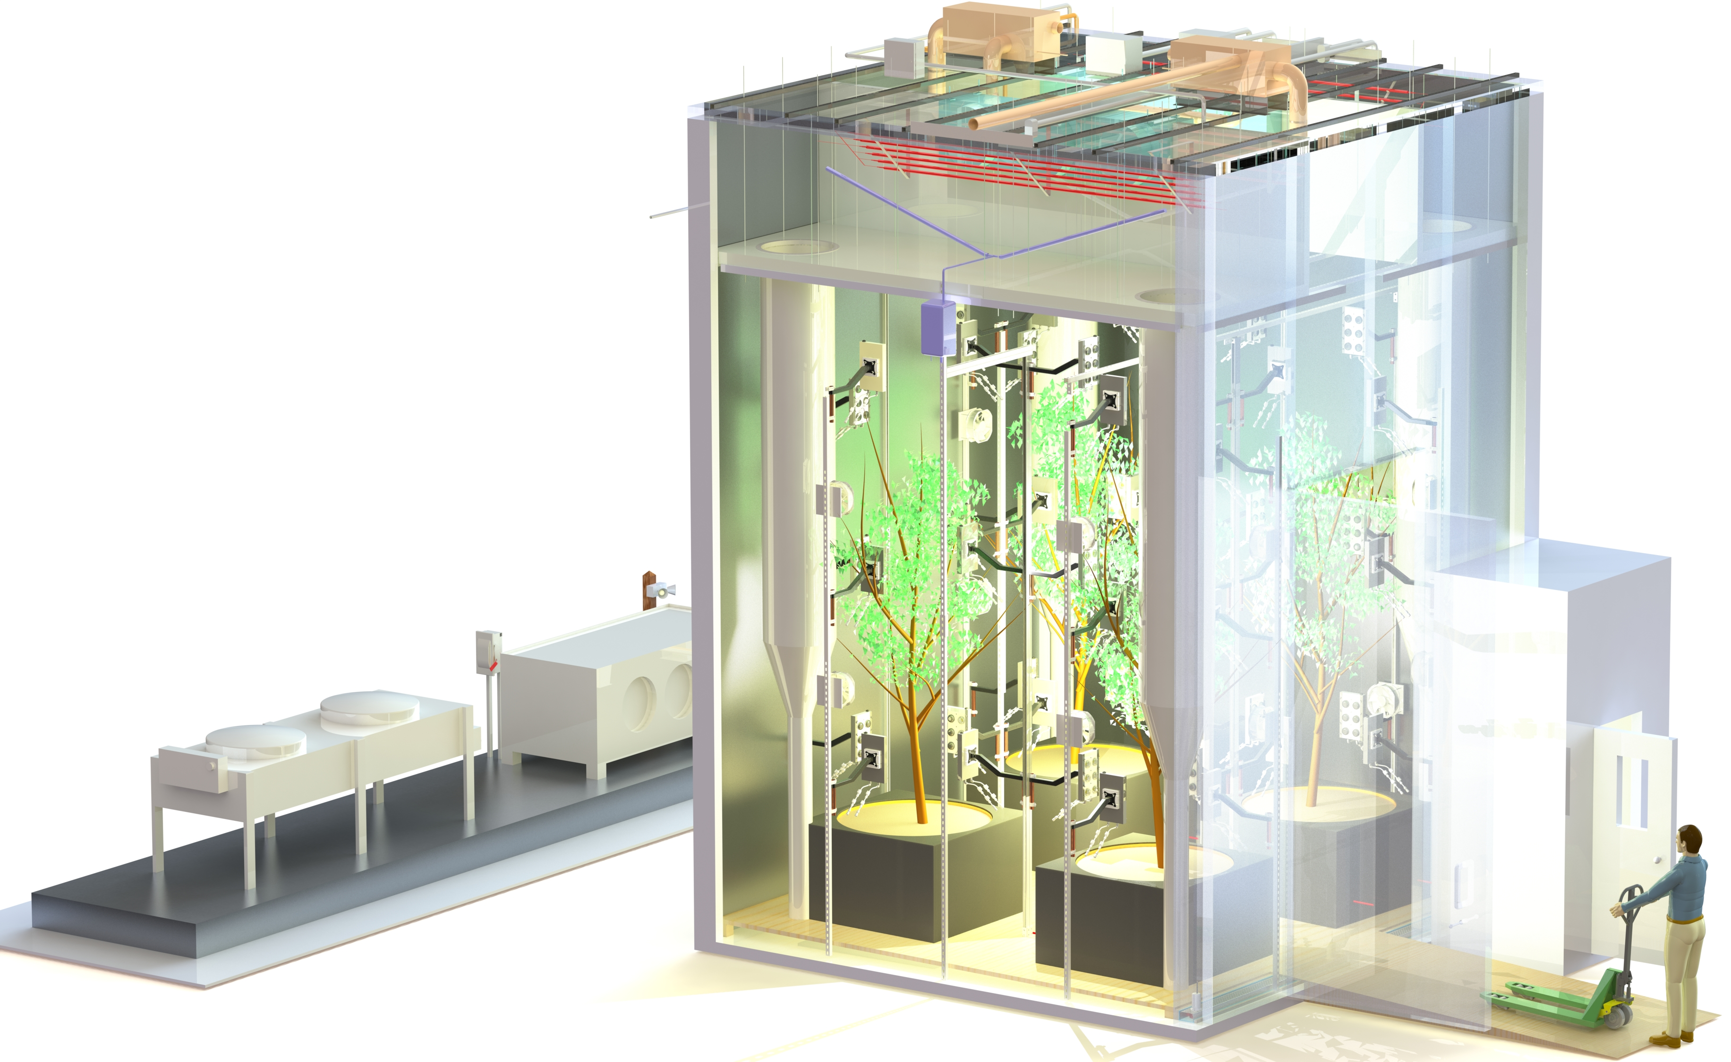
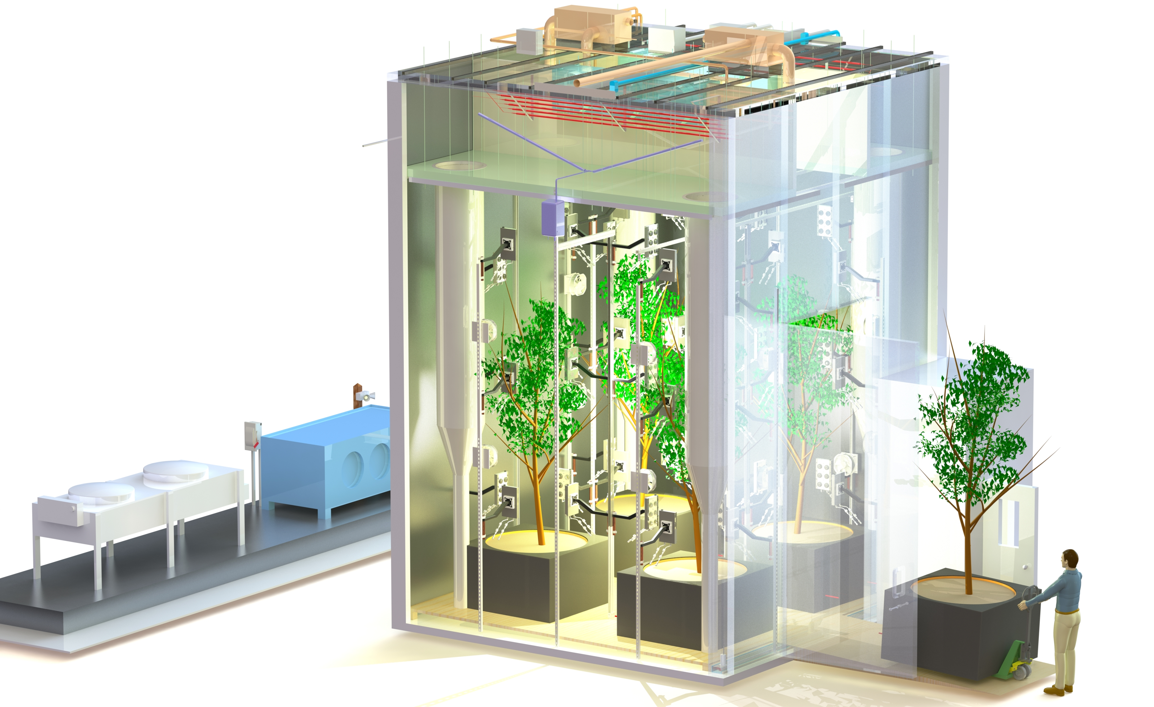
Large Tree Computer Documentation Update for October 2019

Slide 3
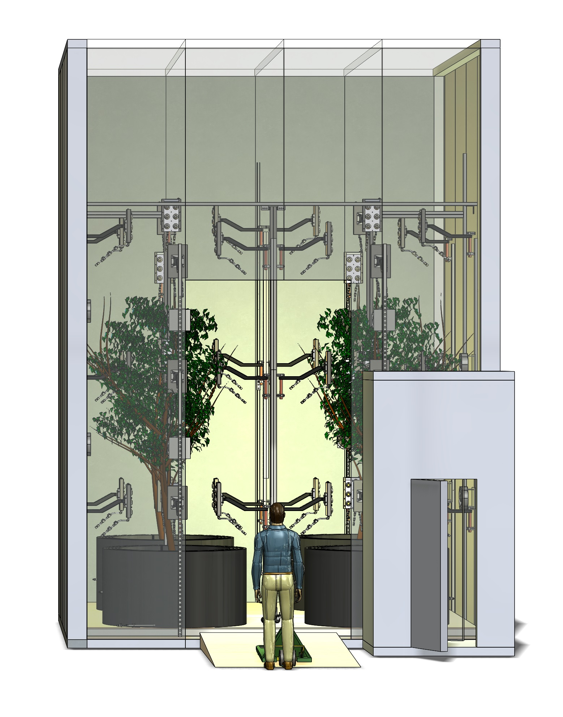
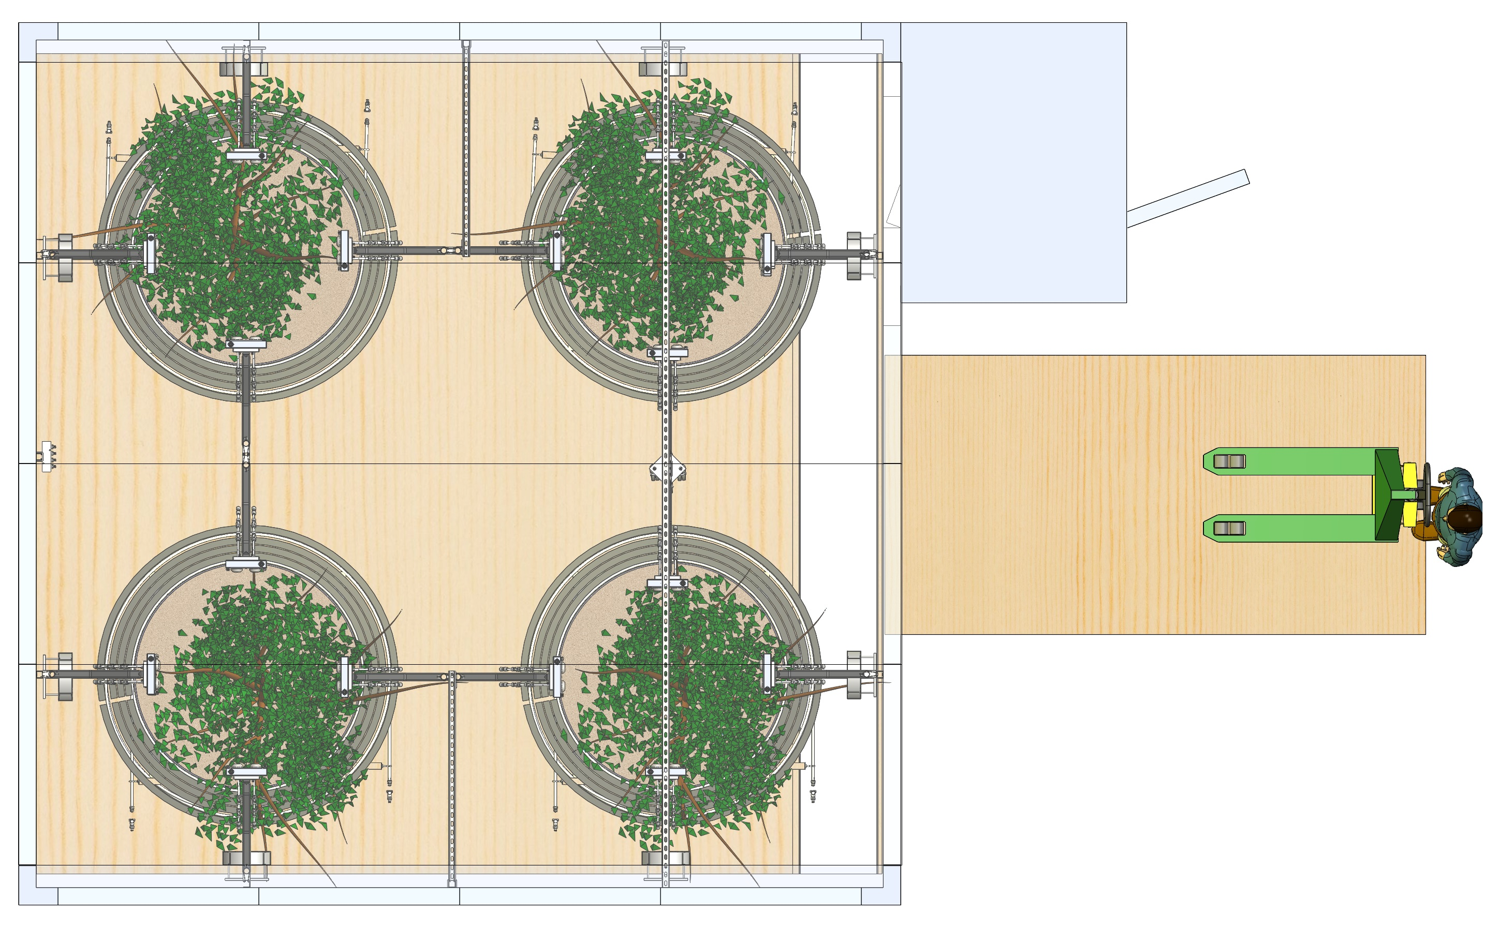
Pot Heating Designs
Footprint and layout considerations
Insulation size considerations

Slide 4
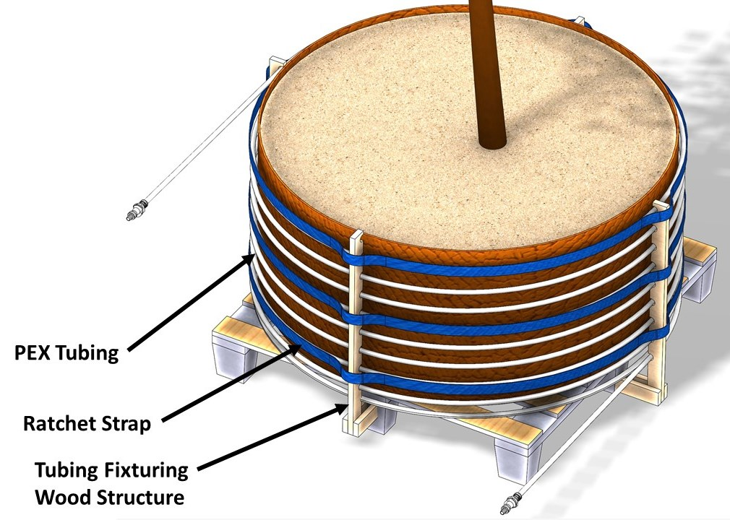
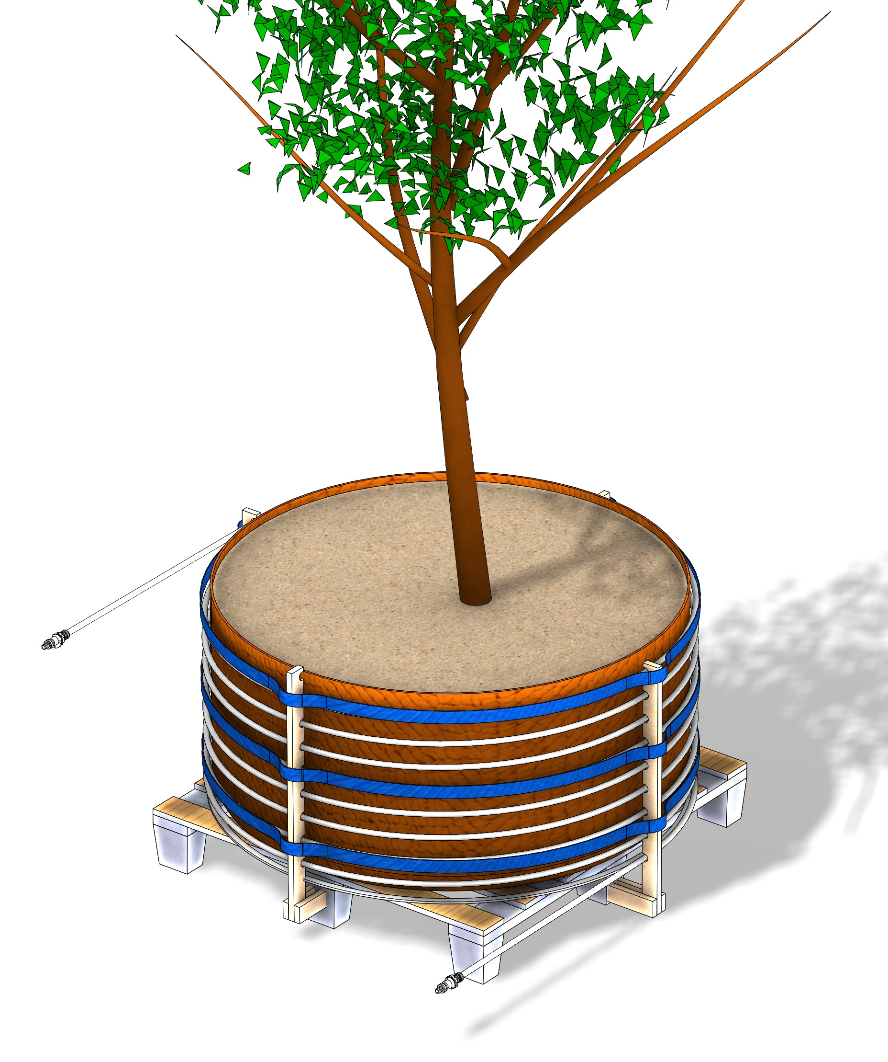
Pot Heating Designs
Wrap-around PEX tube design

Slide 5
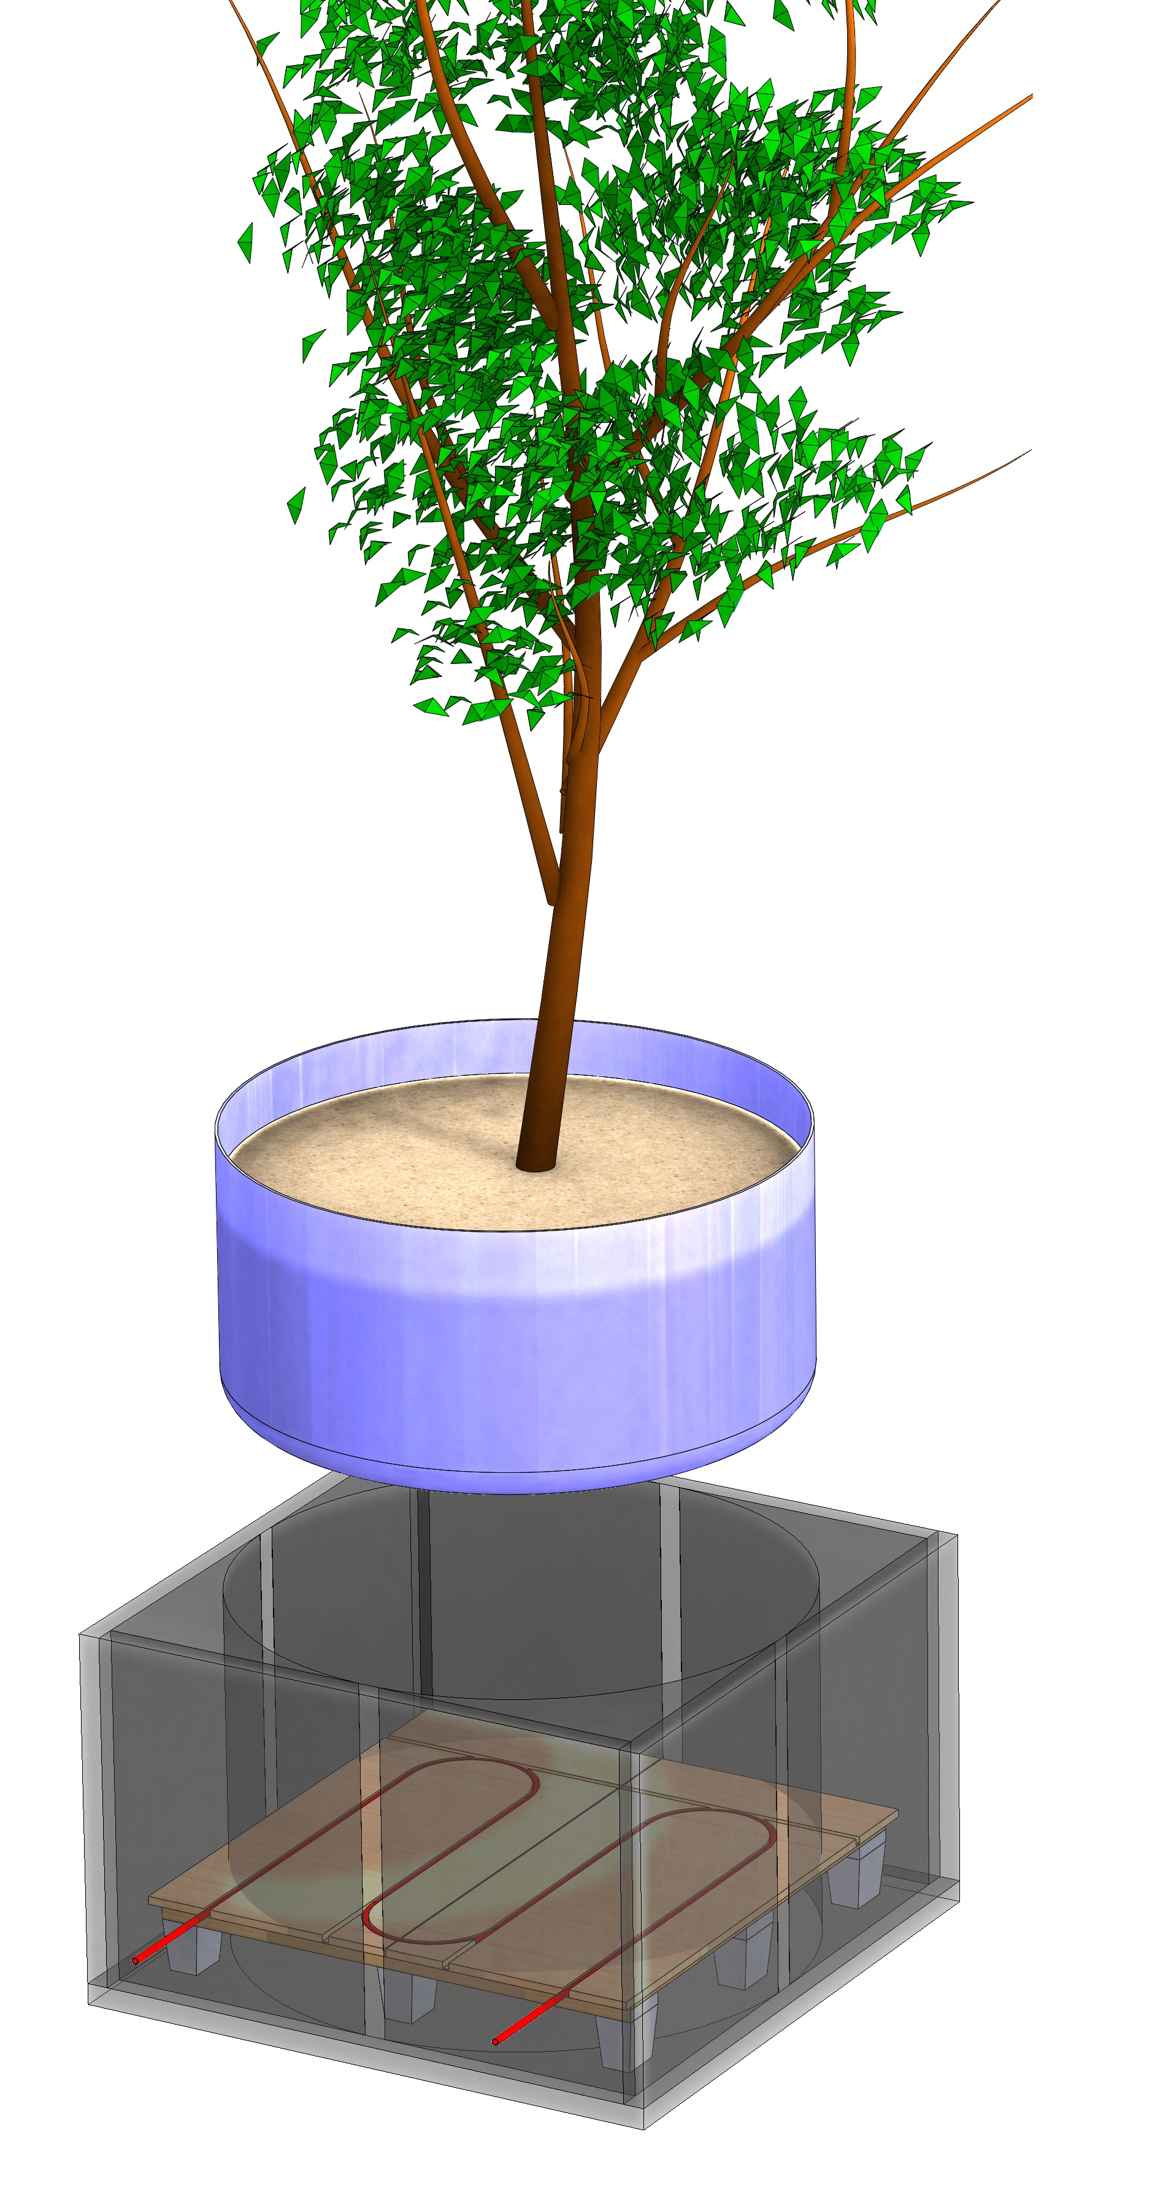
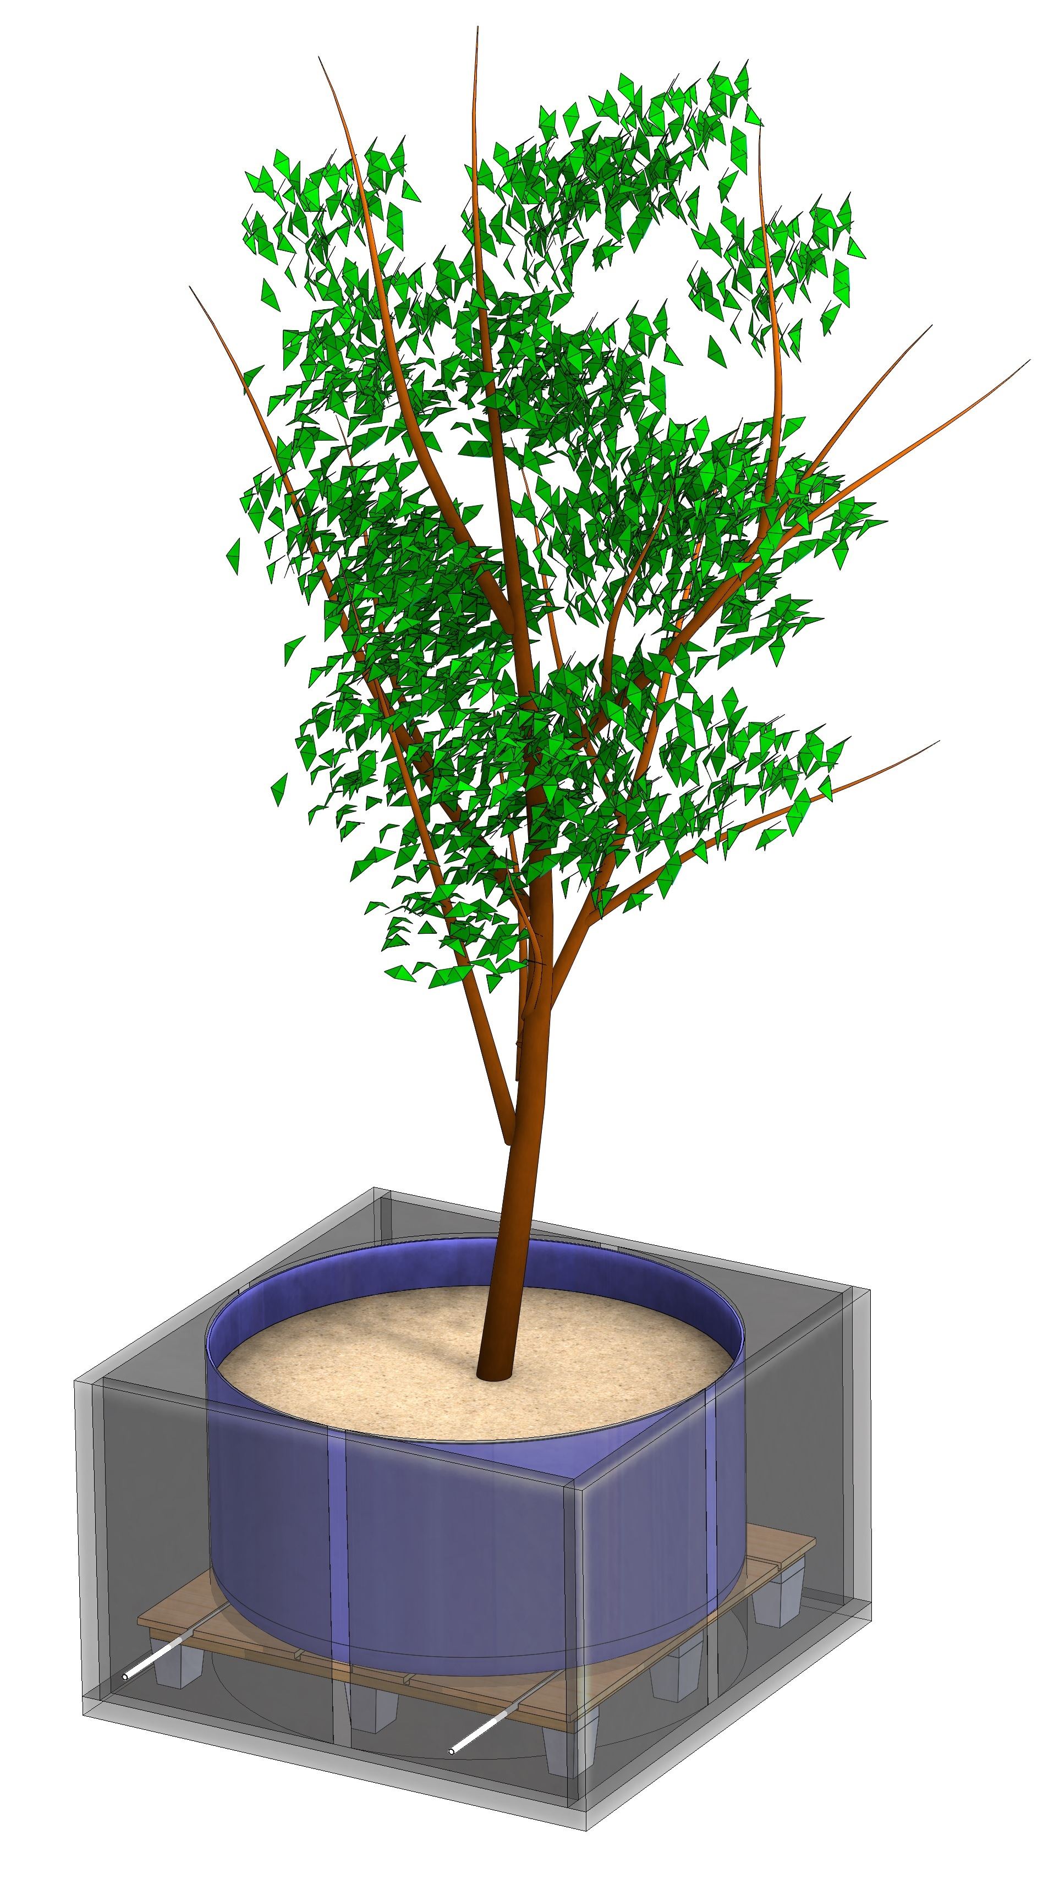
Pot Heating Designs
WarmBoard design

Slide 6
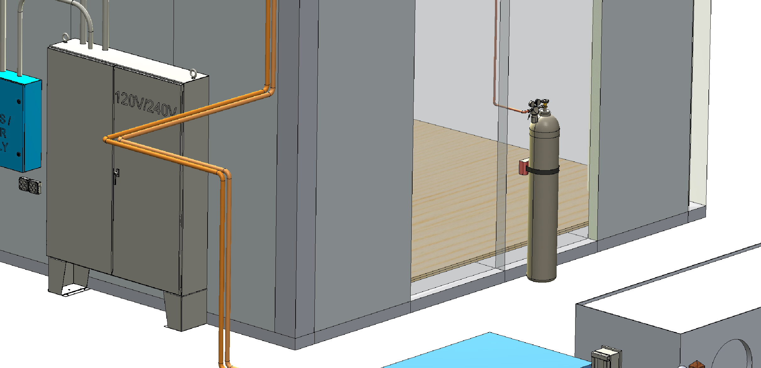
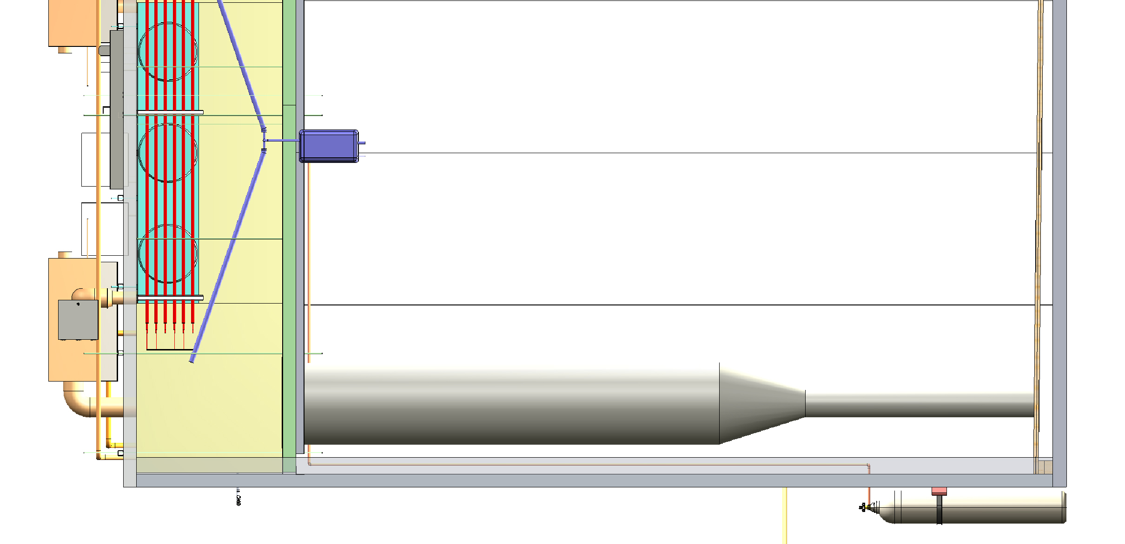
CO₂ Injection System
Gas cylinder location and plumbing layout

Slide 7
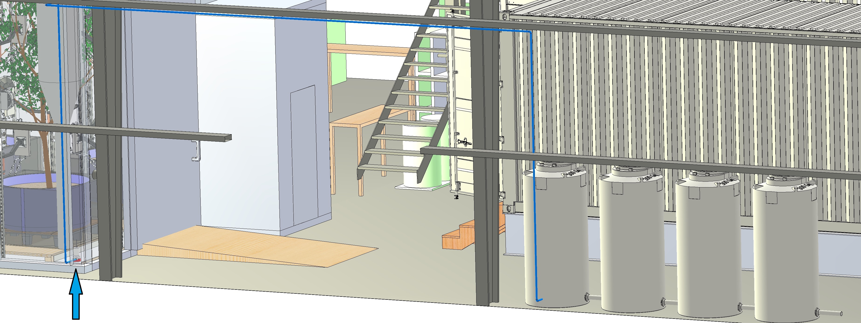
Water Trough Sump Pump
Pump location and plumbing layout

Slide 8
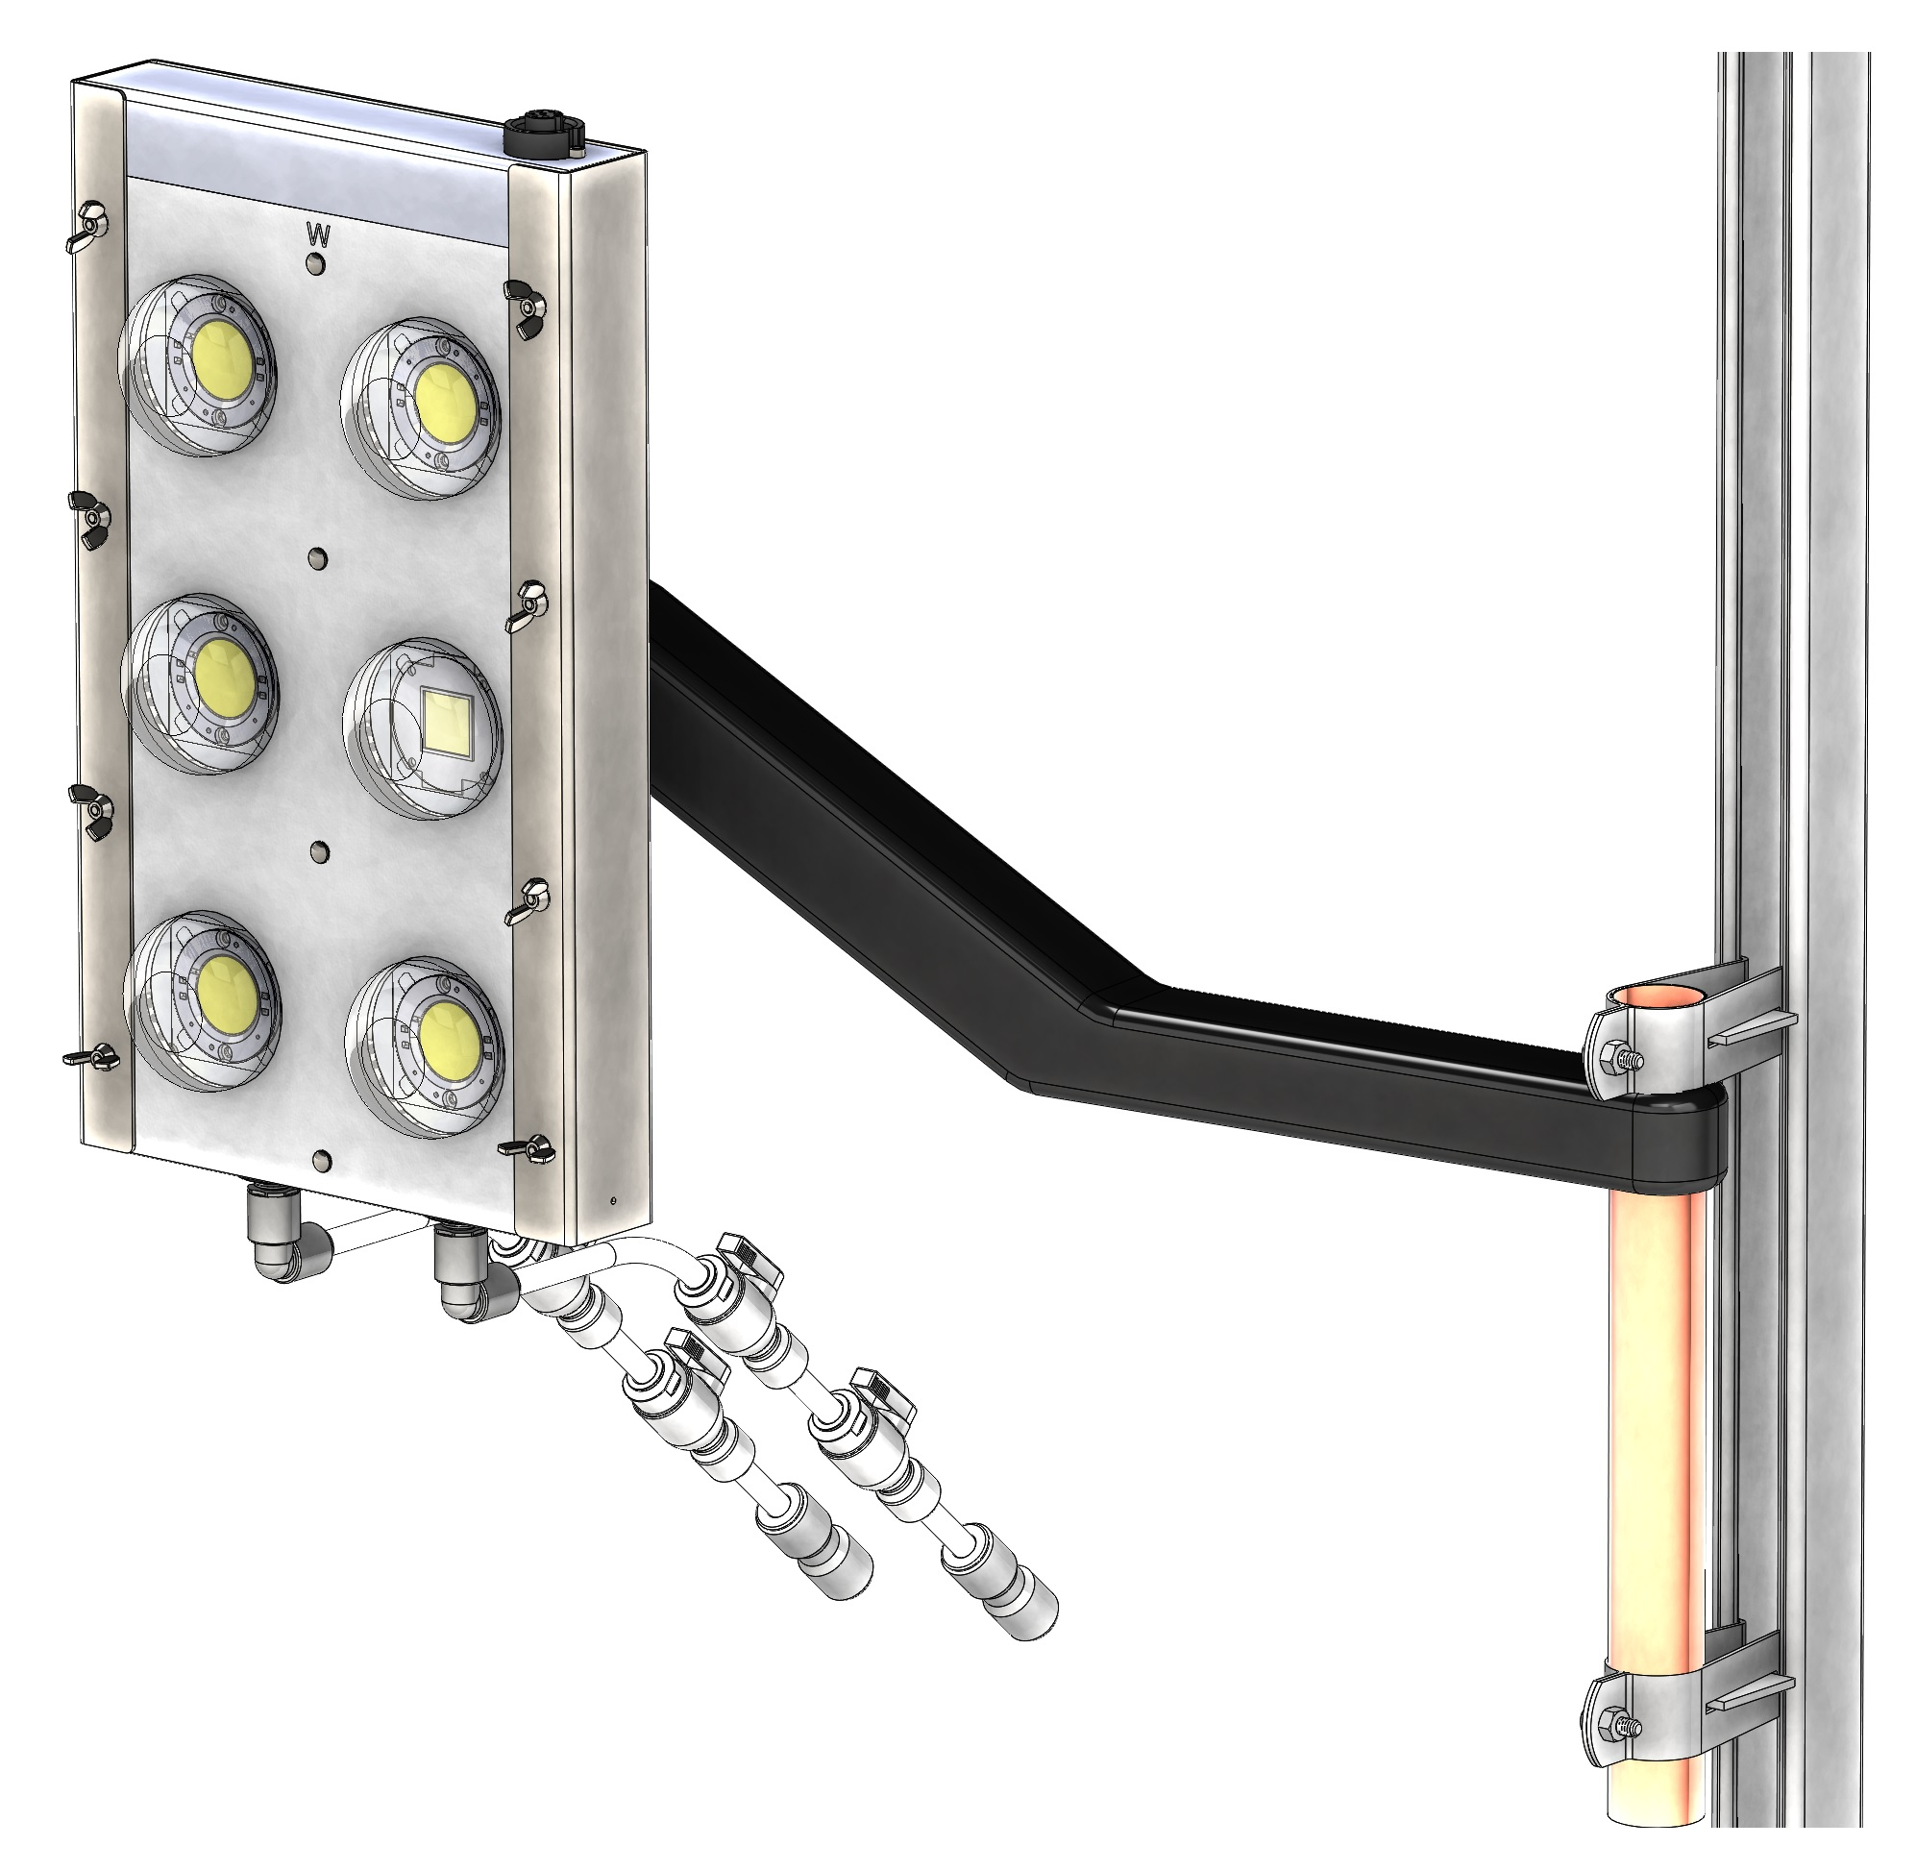
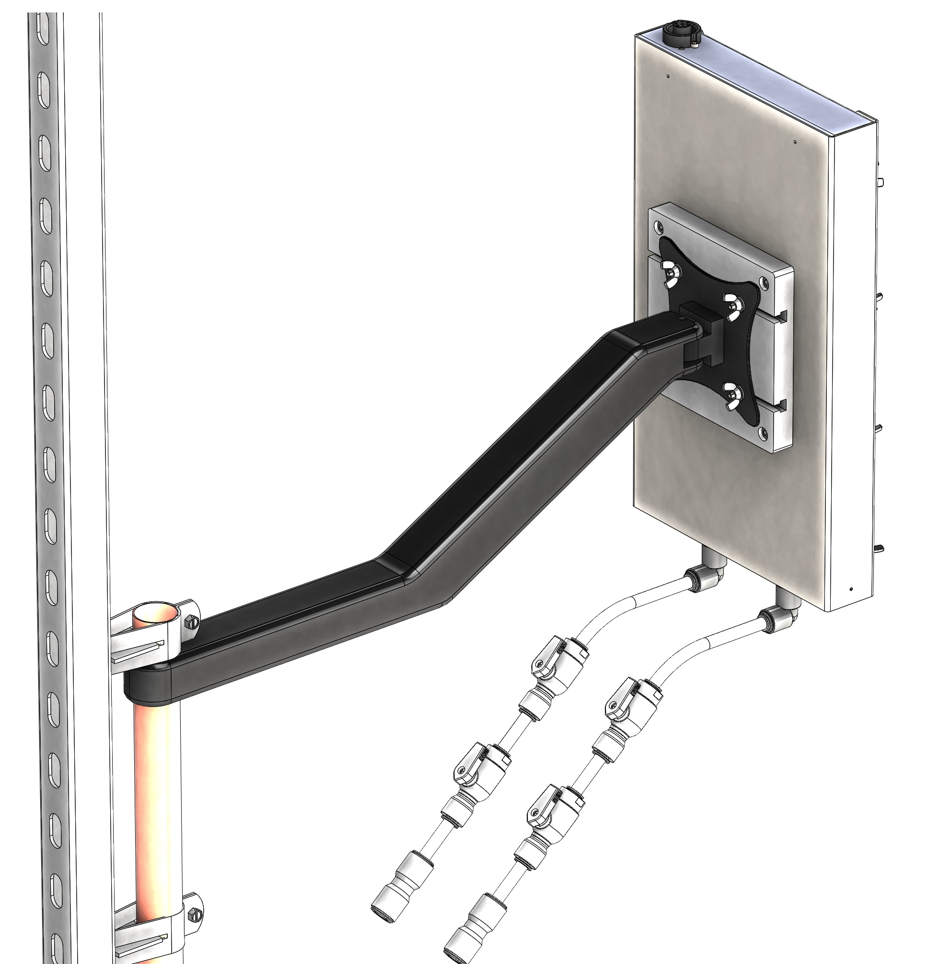
Light Assembly Design
Final renders of finished assemblies

Slide 9
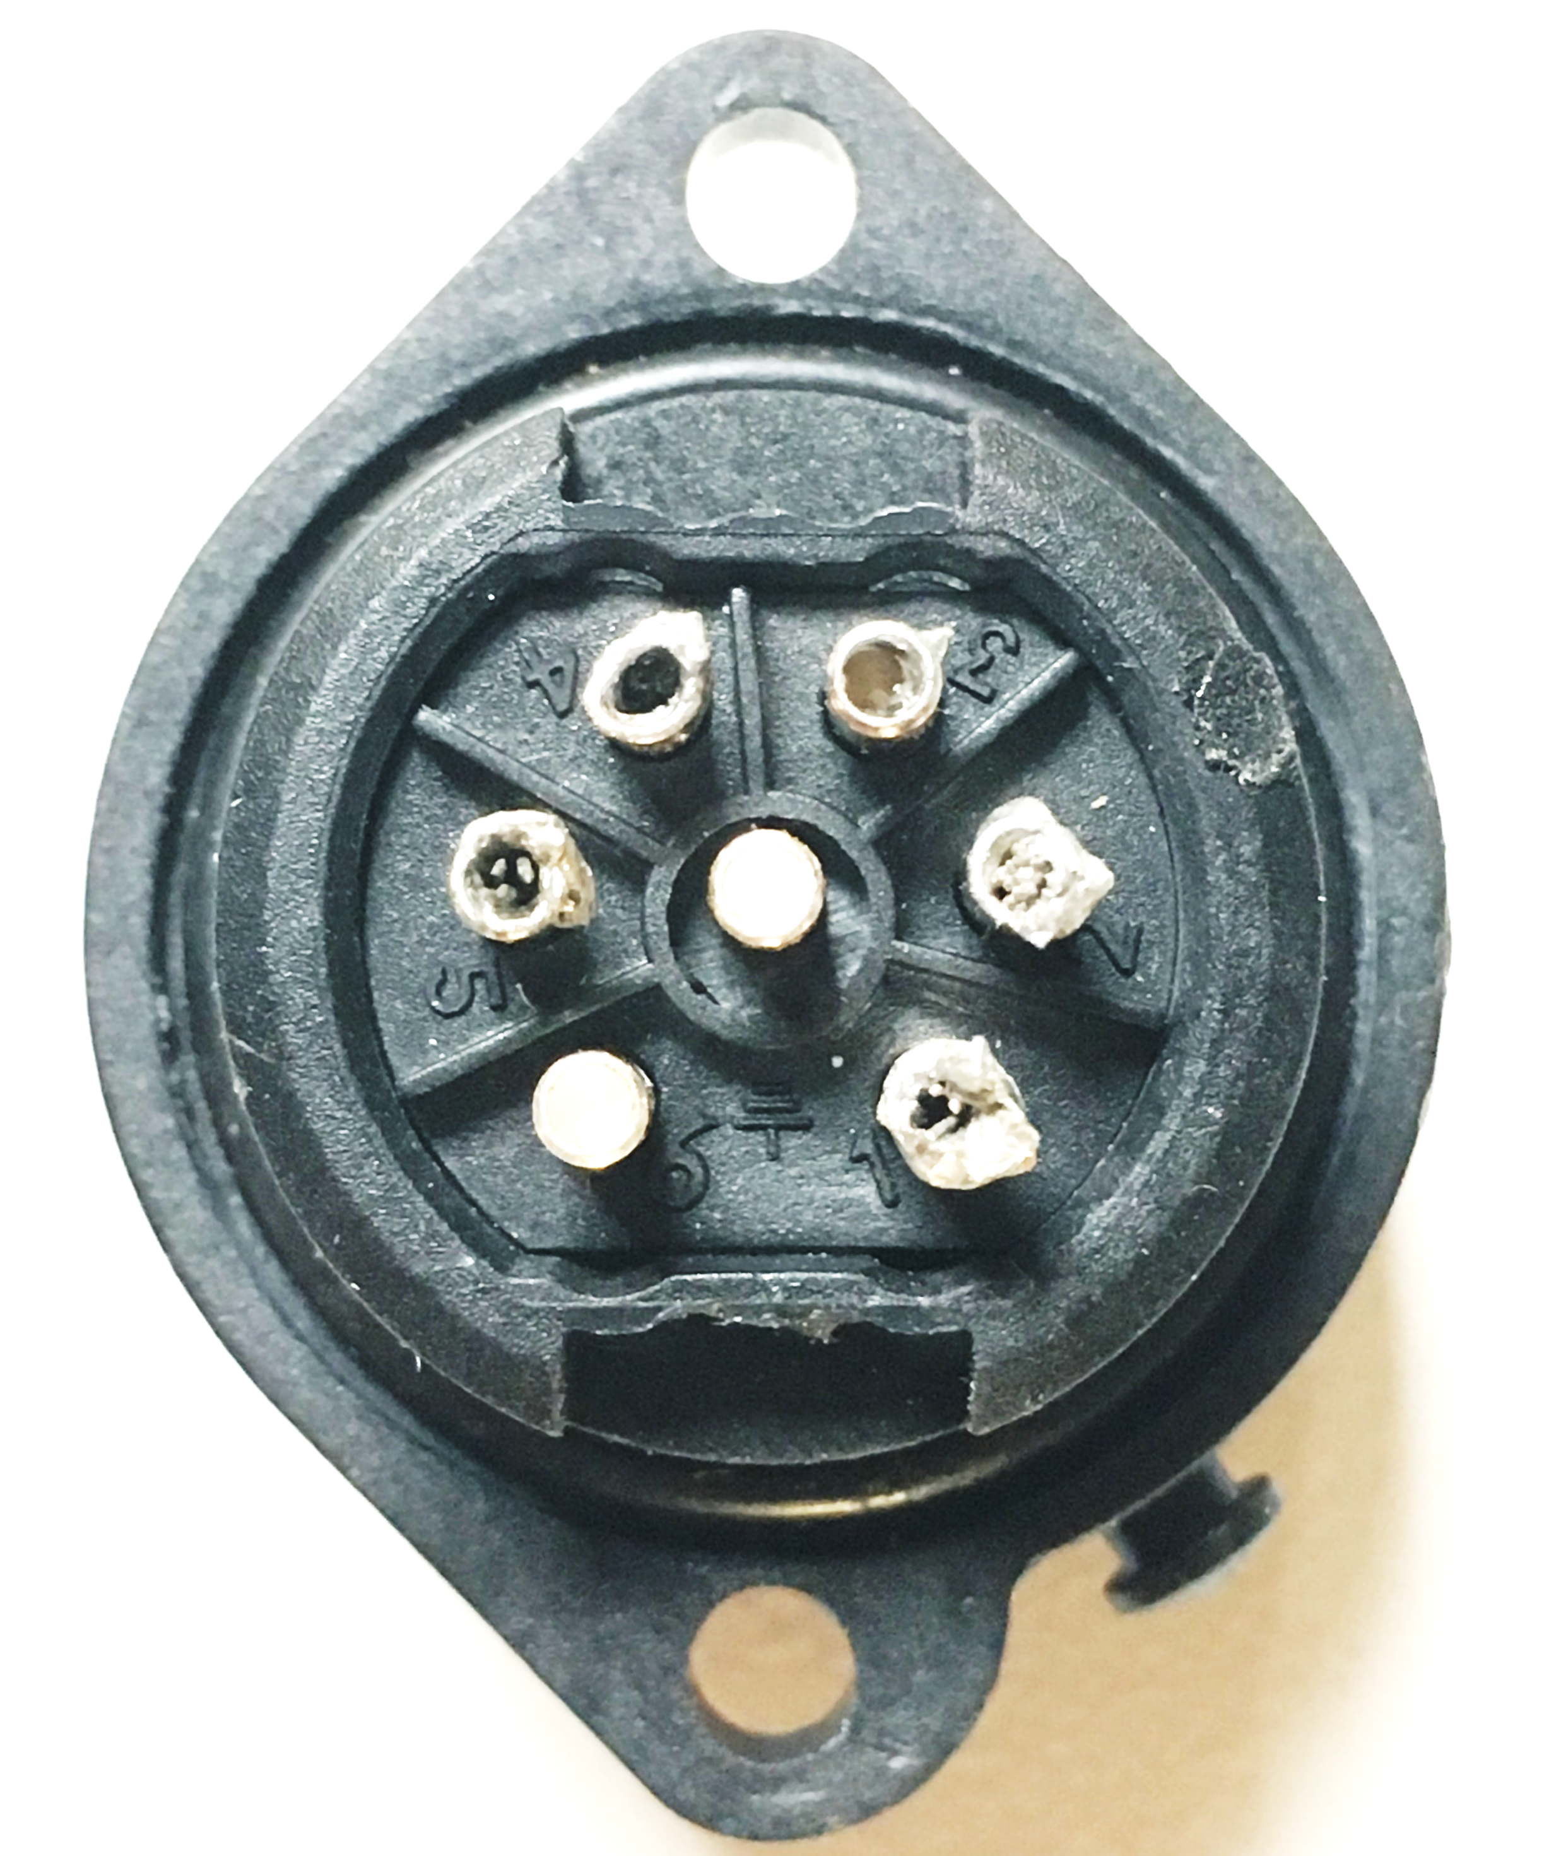
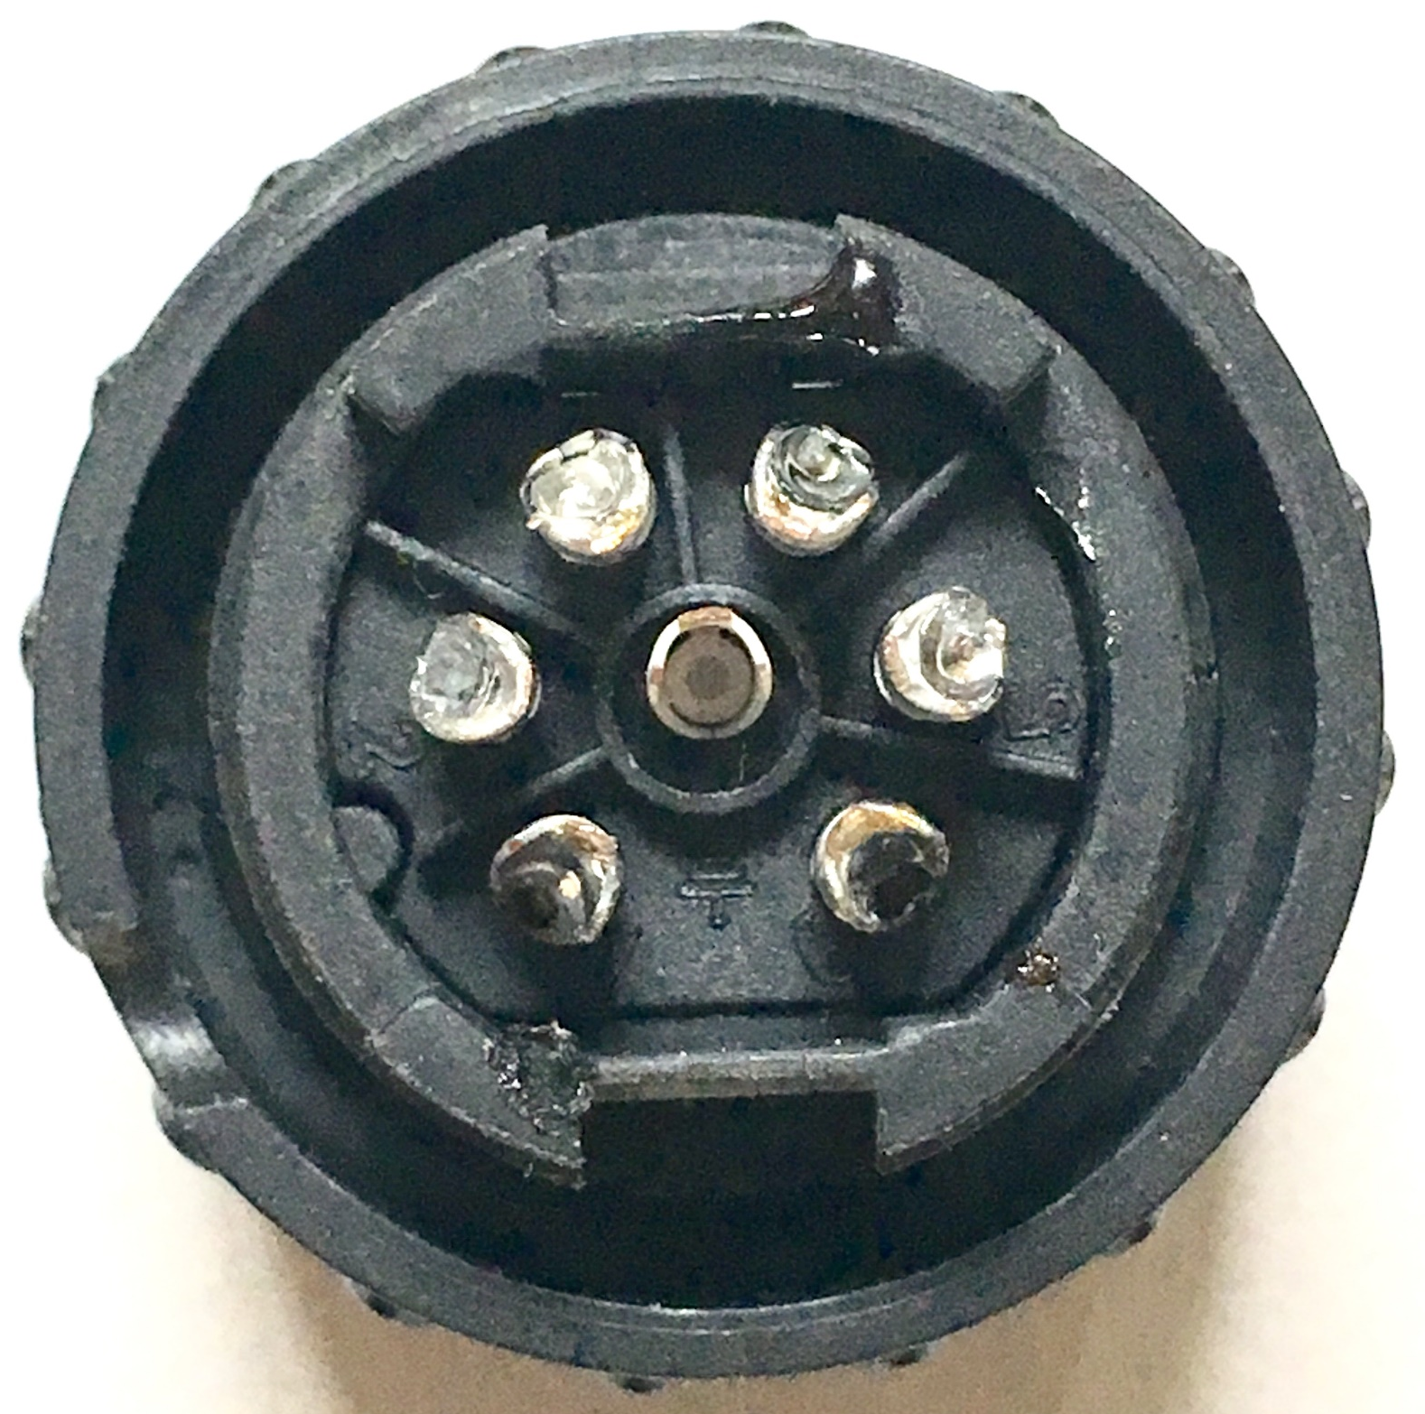
Poles 4/5
ORANGE
On Female (cable) connector:
Green/Blue = Black
Brown/White = Red
Poles 4/5
ORANGE
3
4
5
2
6
1
Poles 3/6
RED
Poles 1/2
YELLOW
Poles 1/2
YELLOW
Poles 3/6
RED
Wiring Diagrams for Light Cables
Documentation of work instructions for technicians to wire cables

Slide 10
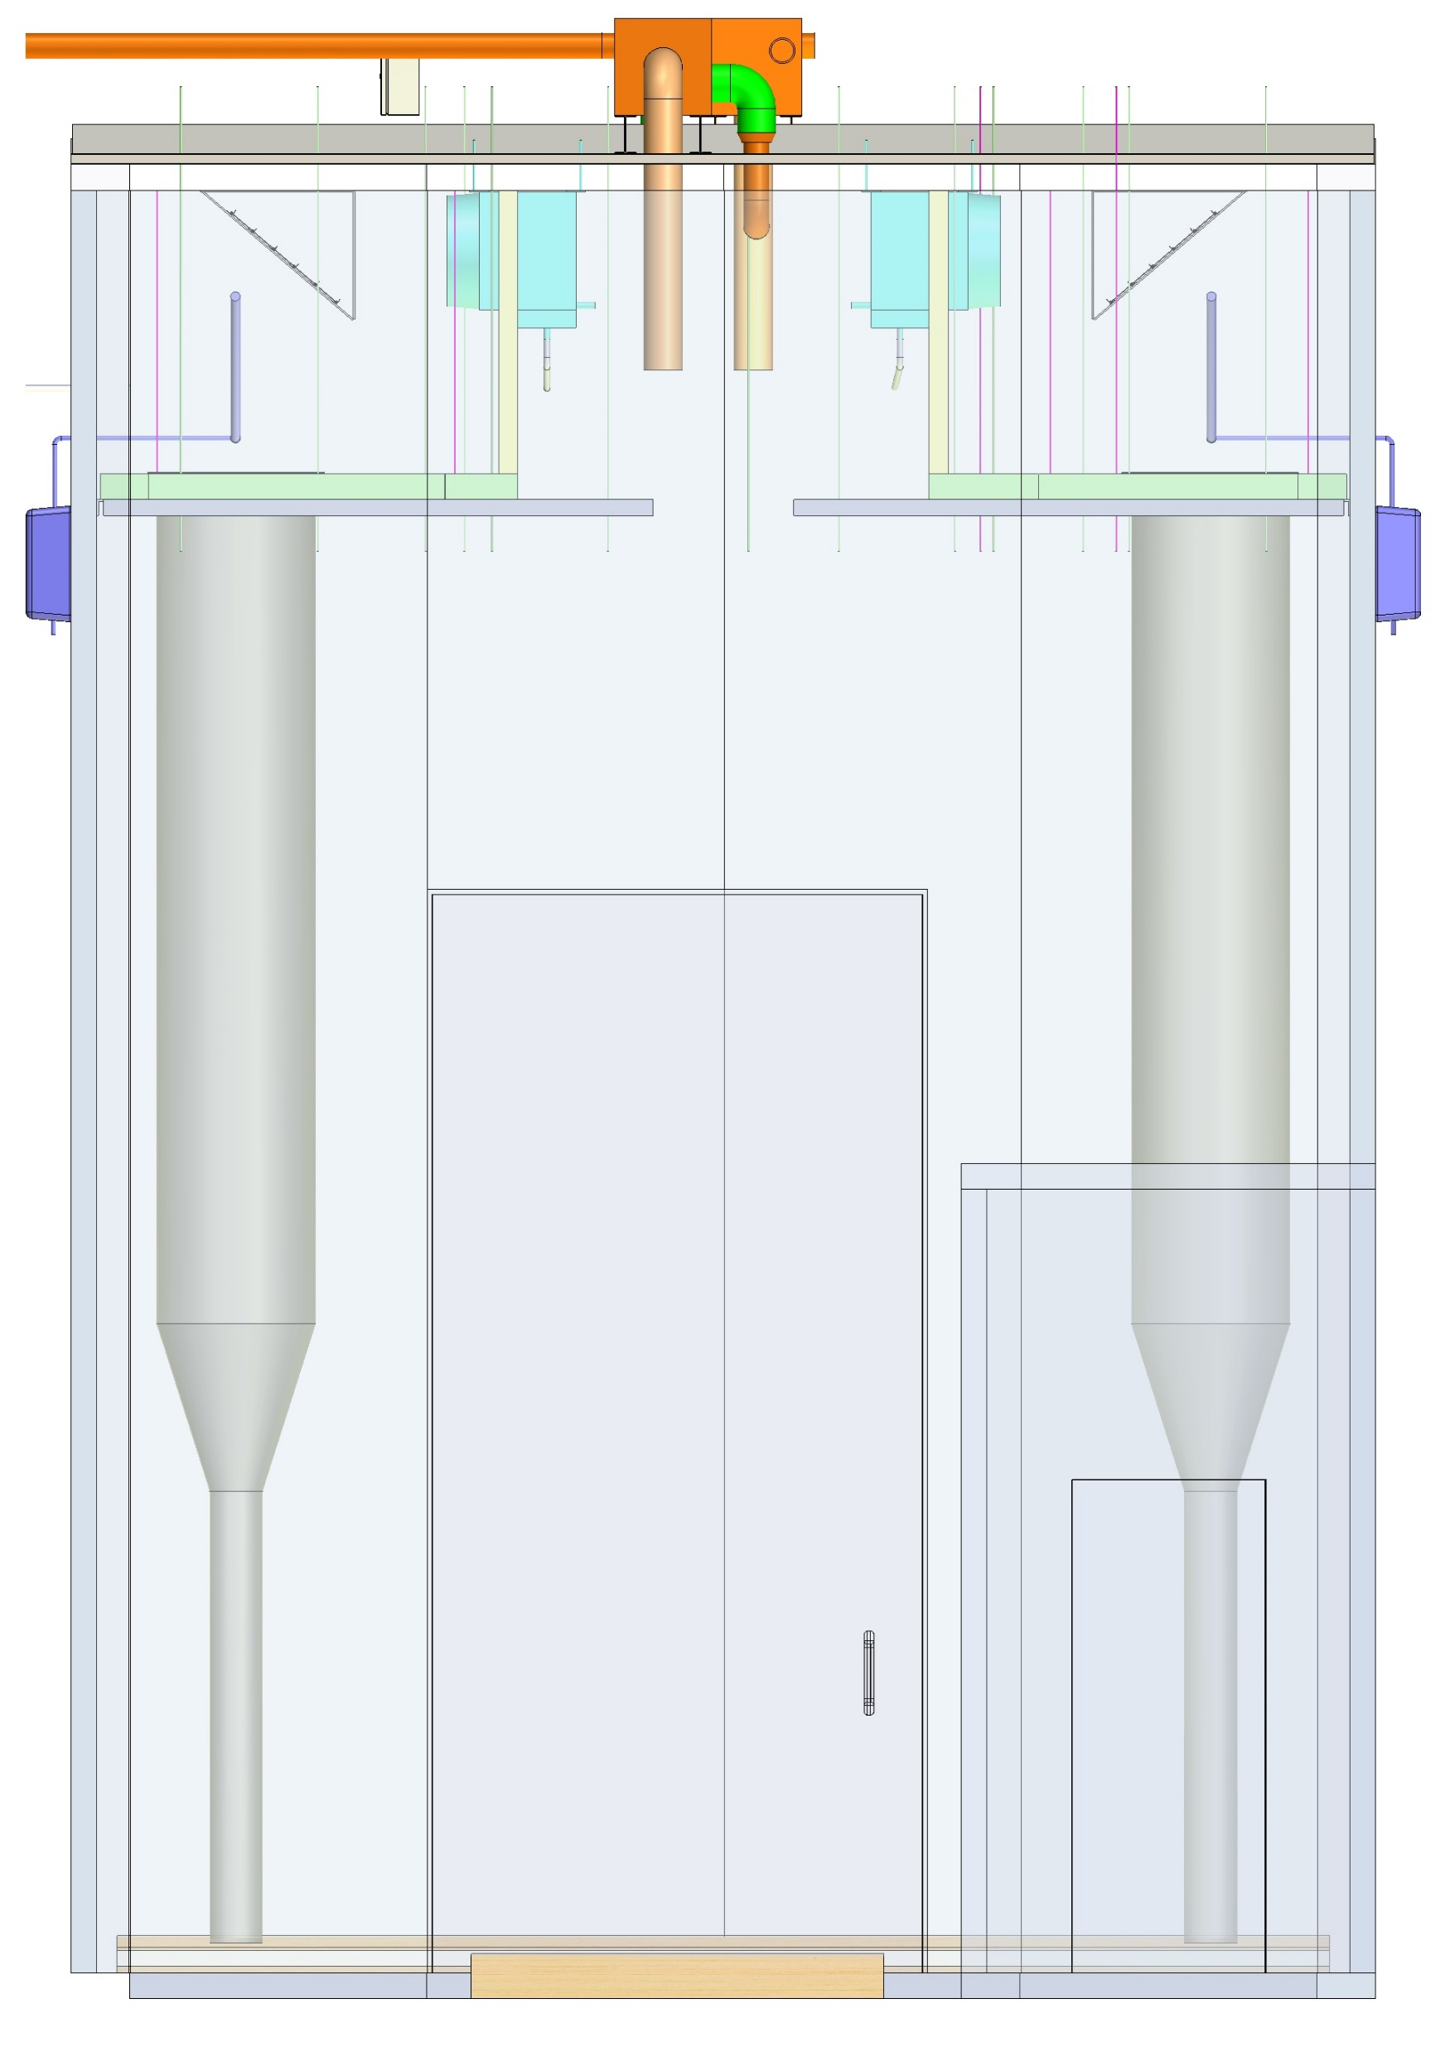
Air Flow
Heating
Cooling
Return
Wetting
Drying
Return
Figure 1. LHC General Air Flow
Figure 2. LHC Heating and Cooling
Figure 3. LHC Wetting and Drying
Air Circulation Diagrams
General Air Flow
Heating and Cooling
Wetting and Drying

Slide 11
Thank You.

